Slide 1



Superstore Report
View in Power BI
Last data refresh:
5/28/2024 12:33:04 AM UTC
Downloaded at:
7/6/2024 8:12:16 PM UTC

Slide 2
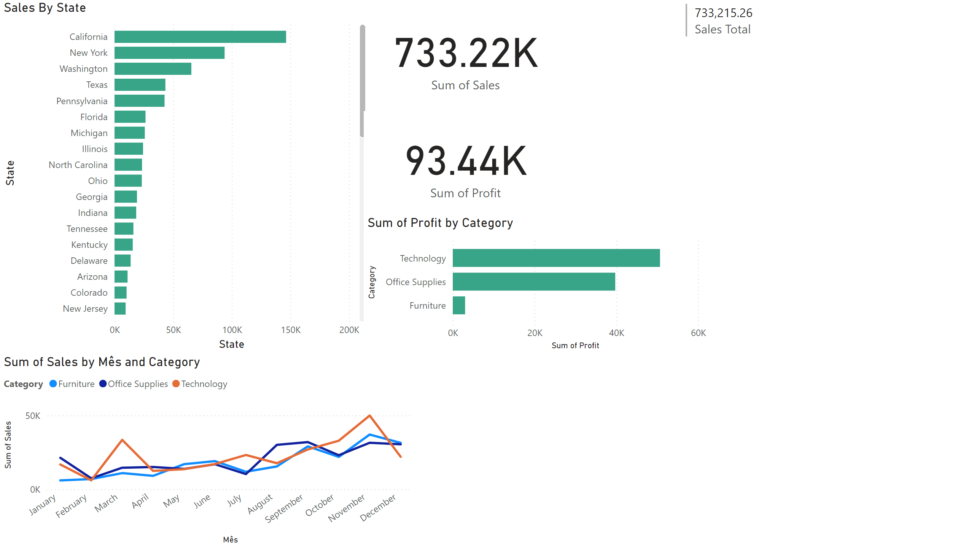
Page 1
Notes:
Quantity by State
No alt text provided
Sales By State
No alt text provided
lineChart
No alt text provided
clusteredBarChart
No alt text provided
card
No alt text provided
multiRowCard
No alt text provided

